Slide 1
Introduction TO HTML & CSS

Slide 2
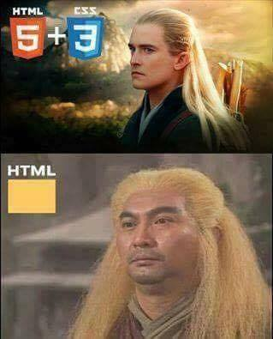

Slide 3
HTML

Slide 4
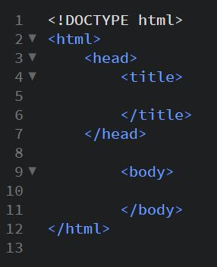
- What is HTML ?
- The main Tags of HTML :

Slide 5
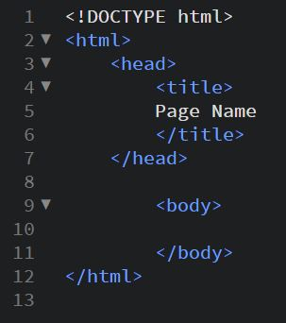
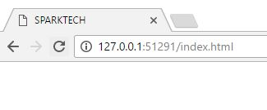
- Title :

Slide 6

- Heading :
<h1>, ……… <h6>

Slide 7

- Paragraph :

Slide 8
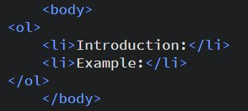
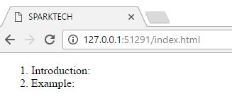
- Ordered List :

Slide 9
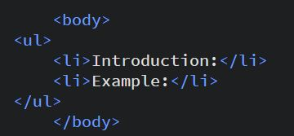
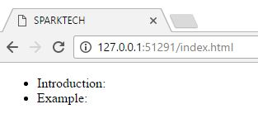
- Unordered List :

Slide 10
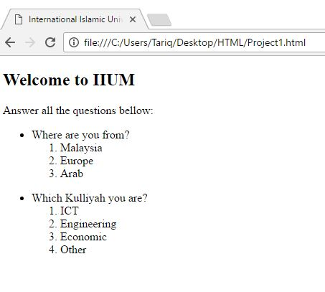
15 minutes
- Project (1) :

Slide 11
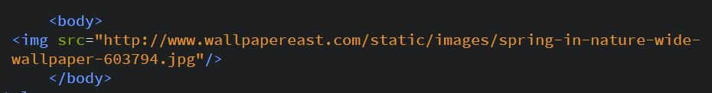
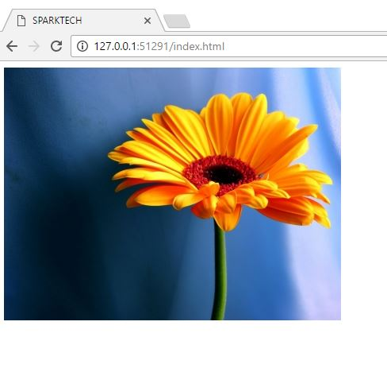
- Picture :

Slide 12

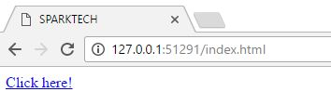
- Link :

Slide 13
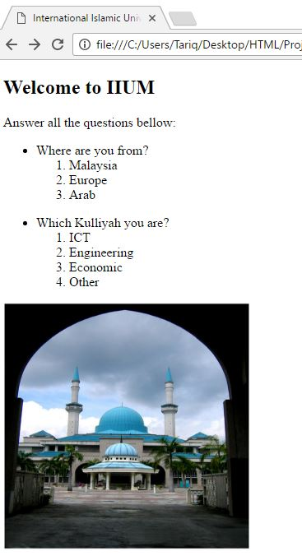
15 minutes
- Project (2) :

Slide 14
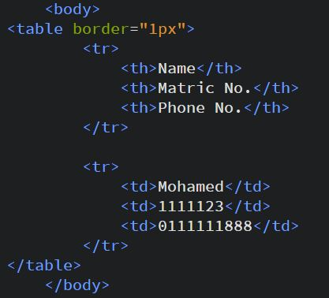
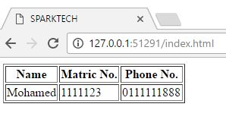
- Table :

Slide 15
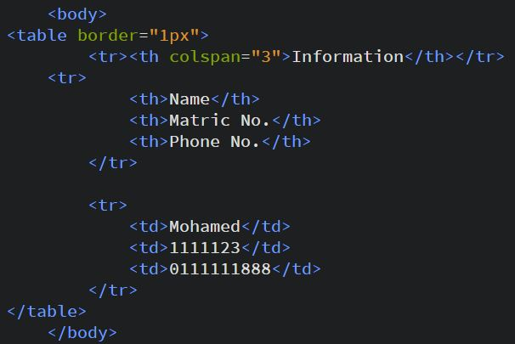
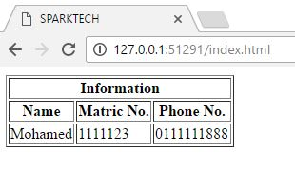
- Naming the table :

Slide 16
- Style :
< Style=“ ”> </ >
1) font-size: 12px
2) color: red OR #ffff00
3) font-family: serif
4) Background-color: red OR #ffff00
5) text-align: center

Slide 17
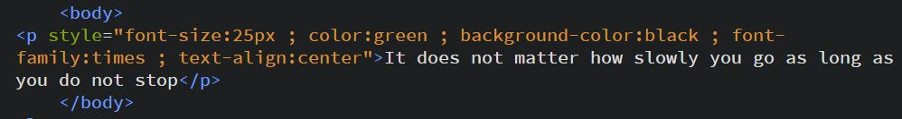
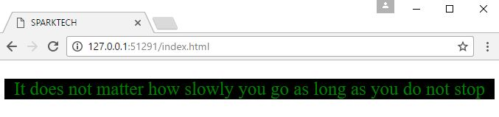
- Example for style the text :

Slide 18
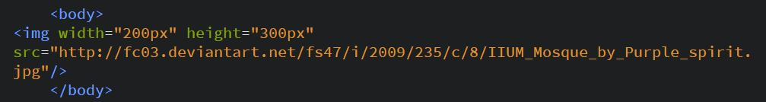
- Style :
-Change the width & height of picture:

Slide 19
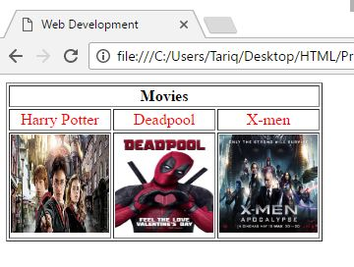
25 minutes
- Project (3) :

Slide 20
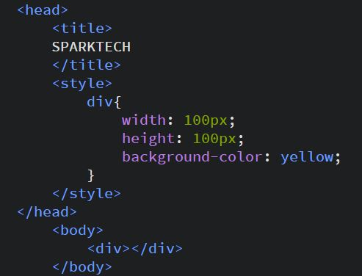
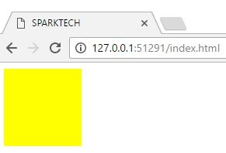
- Divion :

